Slide 1


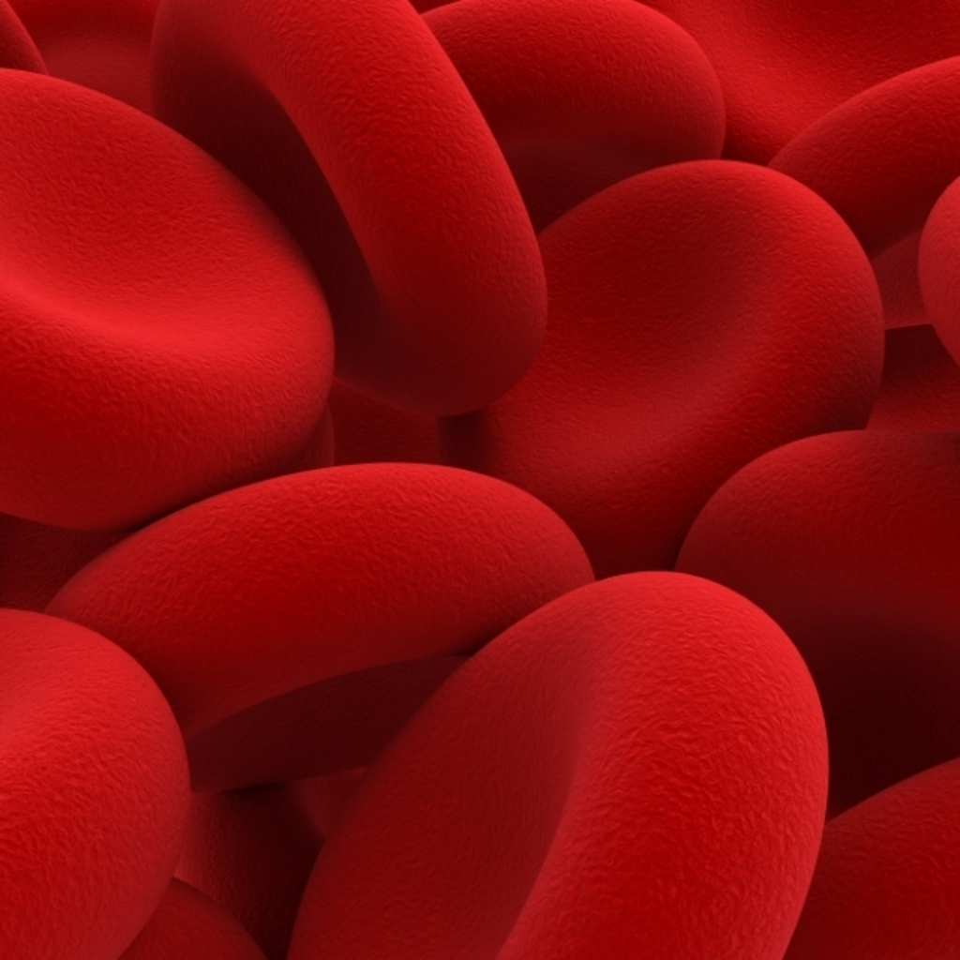
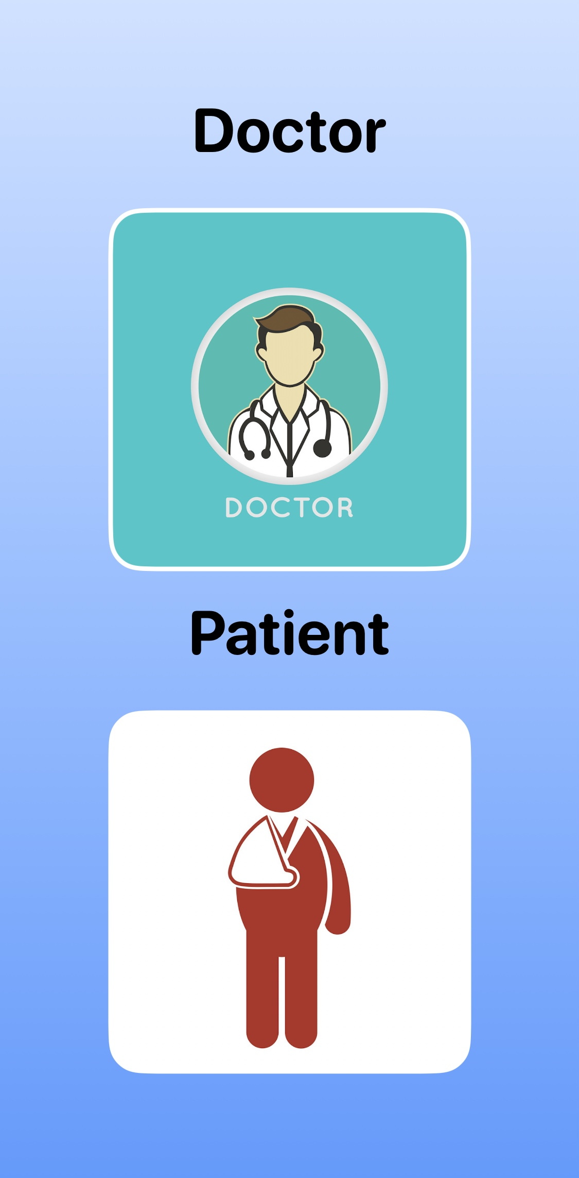
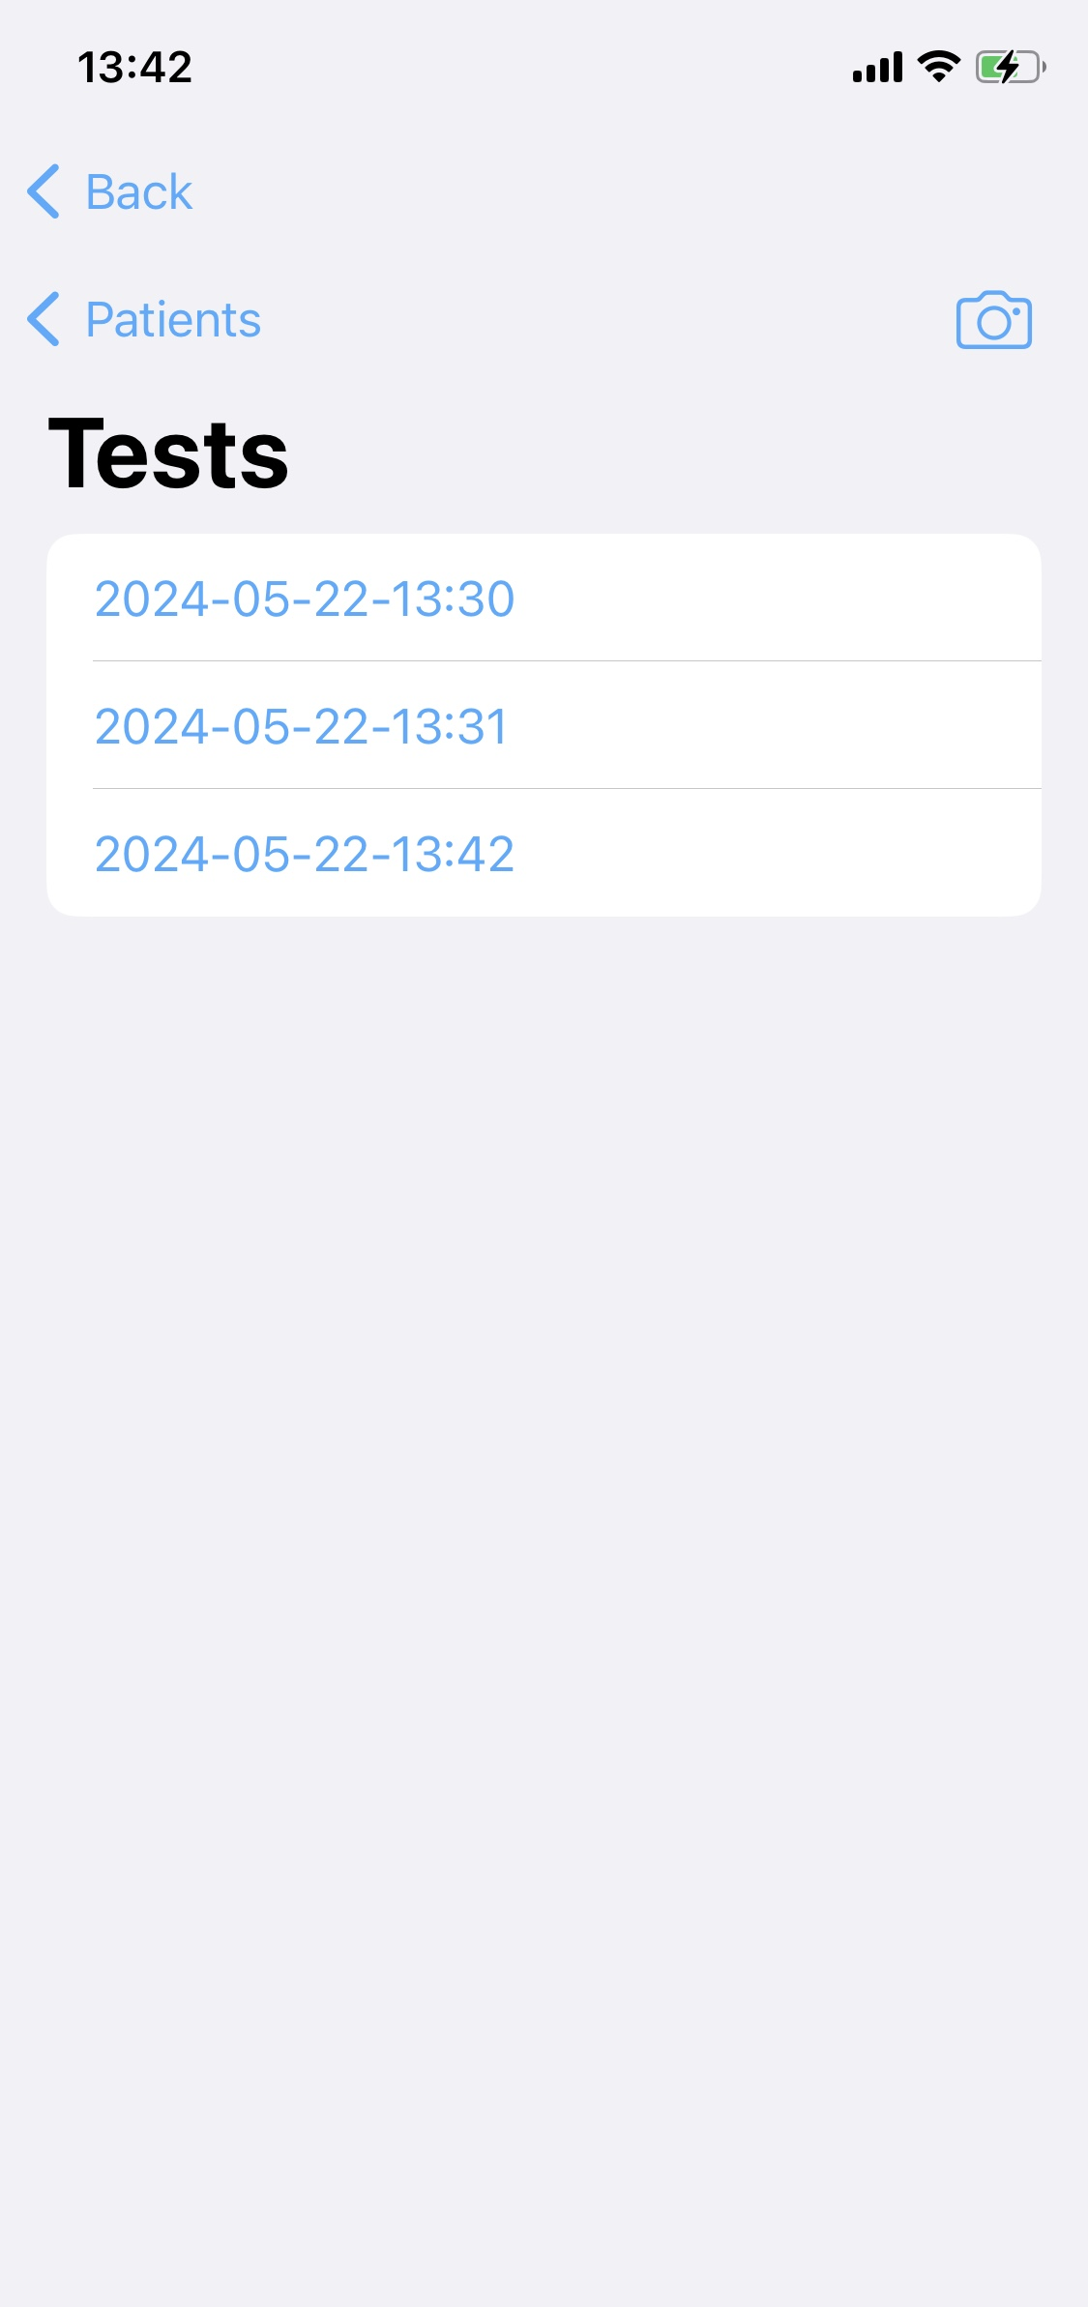
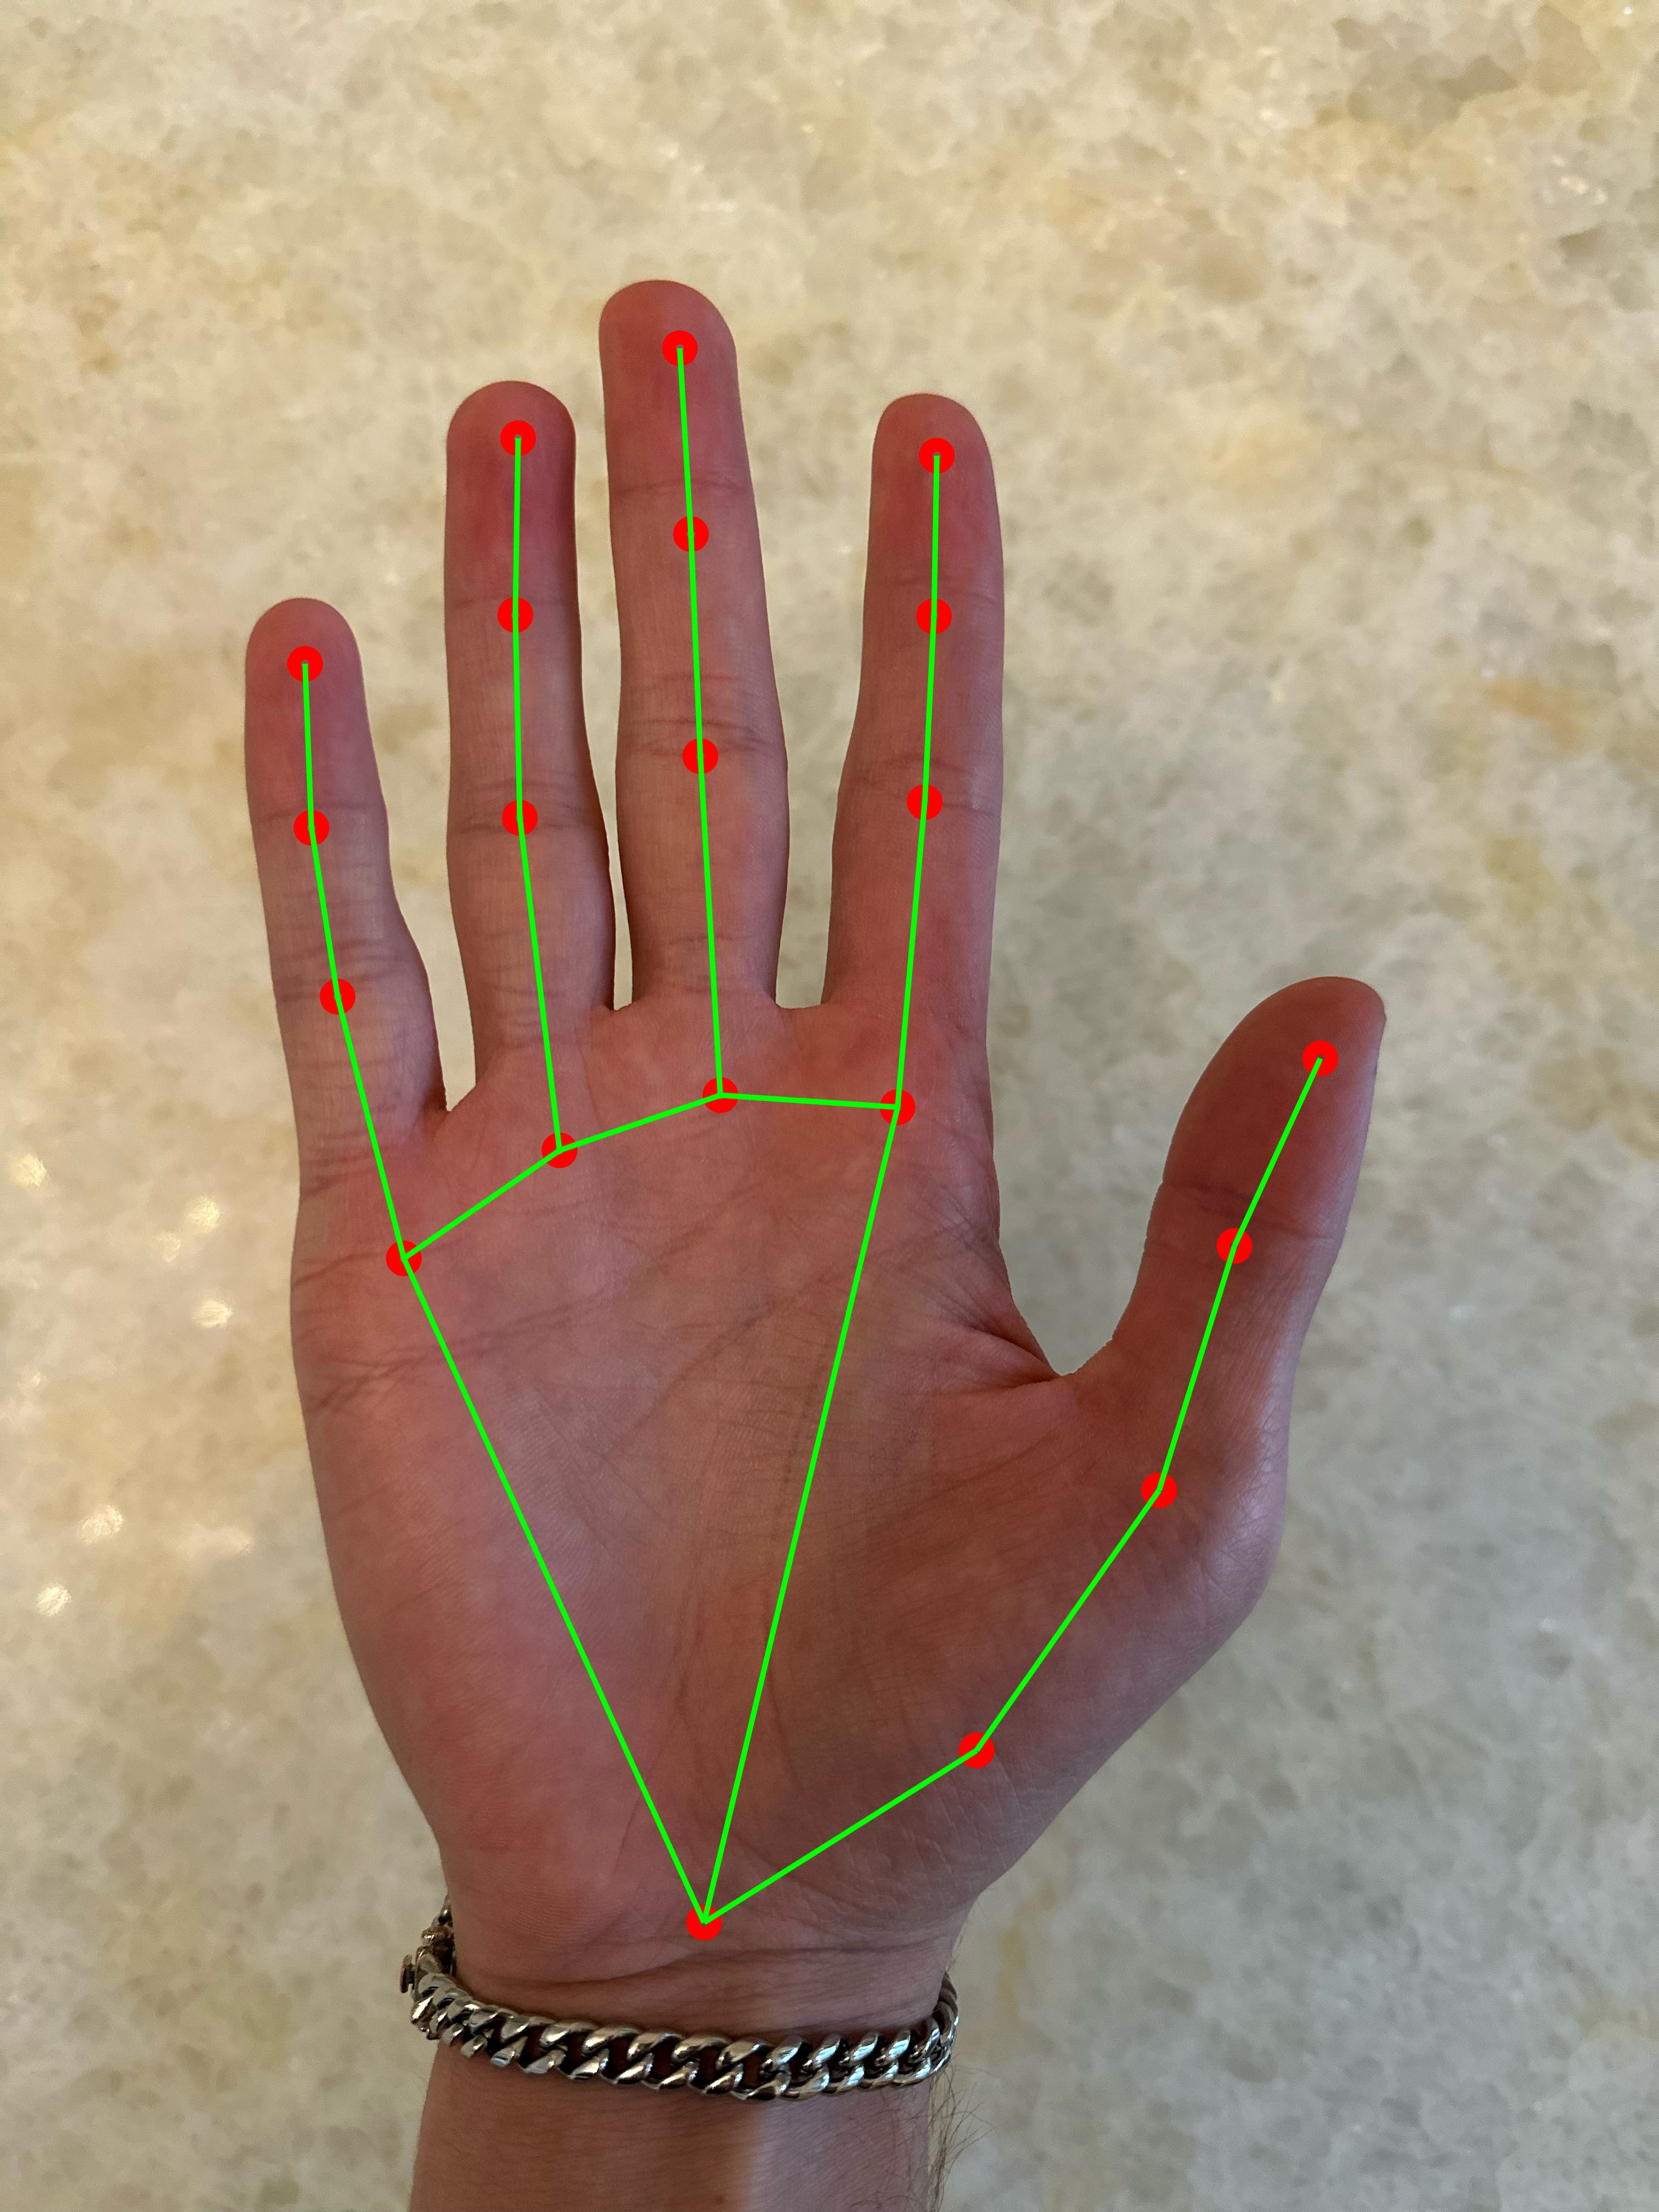
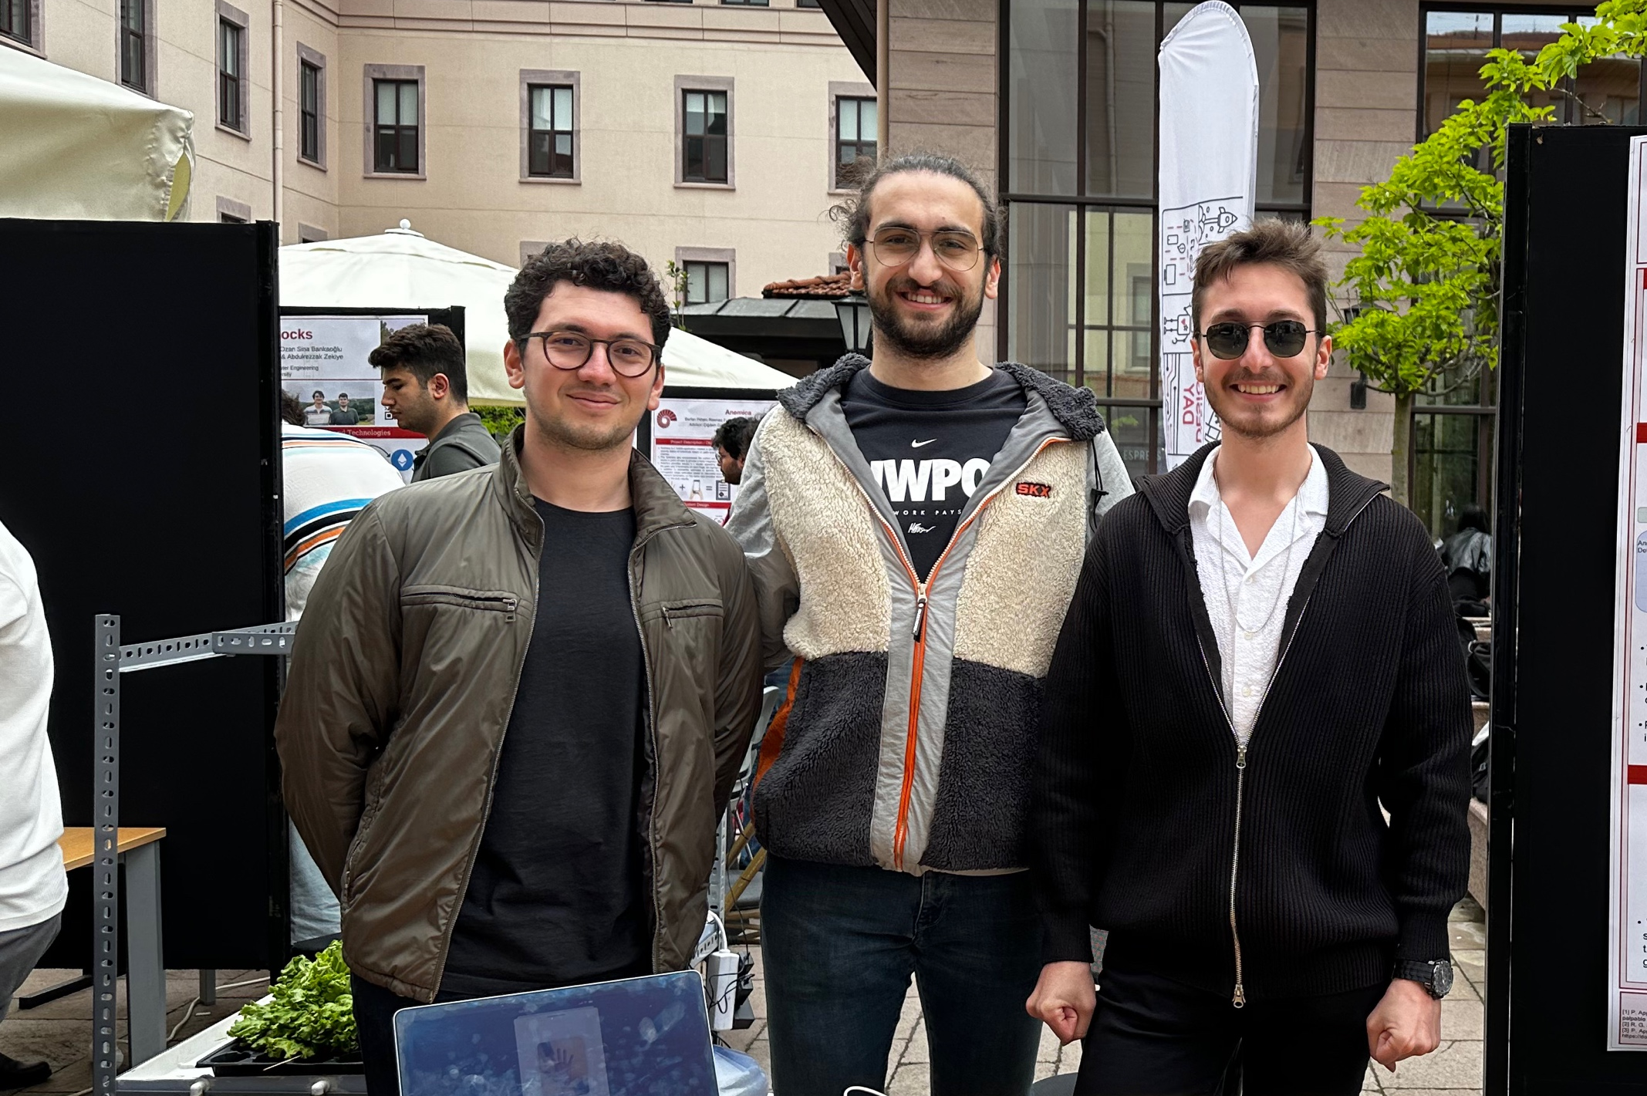
SnapAnemia
TEAM
Emir Fatih AYYILDIZ
Efe Ispır
Umut Zengin
ADVISOR
Anemia is a major disease that affects billions of people. It is caused by not having enough healthy red blood cells or hemoglobin to carry oxygen to the body's tissues. Having anemia can cause tiredness, weakness and shortness of breath. The tests used for detection of this disease are invasive and their results can take around 24 hours to be processed, leading to delays in diagnosis and treatment.
We developed a mobile application, SnapAnemia, capable of diagnosing anemia in seconds, through a simple picture of the patient's hand. SnapAnemia can interact with tests to analyzes a specific part of the hand selected by the user. Additionally, SnapAnemia enhances ongoing care by allowing doctors and patients to monitor past test results stored in the cloud.
Çiğdem Gündüz Demir

